Slide 1
Web Technology-20CS2056 Introduction to HTML
(Hyper Text Markup Language)
Dr. Arul Xavier V M
Assistant Professor

Slide 2

Internet
The Internet is a “network of networks” is the largest computer network in the world that connects billions of computer users.
Father of Internet
Vinton Cerf

Slide 3

WWW
The World Wide Web, commonly known as the Web, is a system of information repository that interlinked hypertext/hypermedia documents accessed via the Internet from all over the world.
Creator:
Tim Berners-Lee,

Slide 4
What is Web Technology?
Web technology refers to the means by which computers communicate with each other using markup languages and multimedia packages.
It gives us a way to interact with hosted information, like websites.
Web technology involves the use of hypertext markup language (HTML), cascading style sheets (CSS), Java Script, PHP, Angular JS, Node Js, MongoDB etc..

Slide 5
Website and Web Application
Website
Collection of Web Pages and other files
A web page (also written as webpage) is a document that is suitable for the World Wide Web and web browsers.
A web browser displays a web page on a monitor or mobile device.
Web Application
A Web application (Web app) is an application program that is stored on a remote server and delivered over the Internet through a browser interface.
The user makes HTTP request via browser and it is processed by server side program and generates the HTTP response to browser.

Slide 6
Web Page
A web page or webpage is a document, commonly written in HTML, that is viewed in an Internet browser.
A web page can be accessed by entering a URL address into a browser's address bar.
A web page may contain text, graphics, and hyperlinks to other web pages and files.

Slide 7
What is HTML?
HTML is a markup language for describing the structure of web documents (web pages).
HTML stands for Hyper Text Markup Language
A markup language is a set of markup tags
HTML documents are described by HTML Elements(tags).
Each HTML tag describes different document content
Html document must be stored with an extension “.html”

Slide 8
HTML Elements
An HTML element is defined by a start tag, some content, and an end tag:
The HTML element is everything from the start tag to the end tag:
Example
<tagname>Content goes here...</tagname>
<html></html>
<body>Visual Content Goes Here</body>

Slide 9

Who invented HTML?
Tim Berners-Lee
He invented world wide web(www) in 1989.
He invented HTML in 1991
Later, it was enhanced by W3C
The World Wide Web Consortium (W3C) is an international community that develops open standards to ensure the long-term growth of the Web and it is Led by Web inventor and Director Tim Berners-Lee
https://www.w3.org/
HTML5 is the latest evolution of the standard that defines HTML

Slide 10
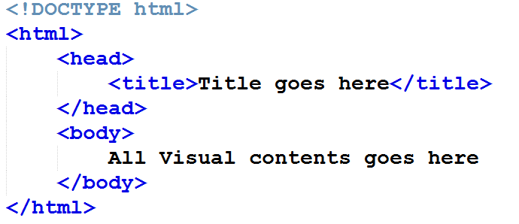
HTML Document Structure
defines this document to be HTML5

Slide 11
<!DOCTYPE HTML>
All HTML documents must start with a <!DOCTYPE> declaration.
The declaration is not an HTML tag.
It is an "information" to the browser that the document type to be as HTML 5 standard.

Slide 12
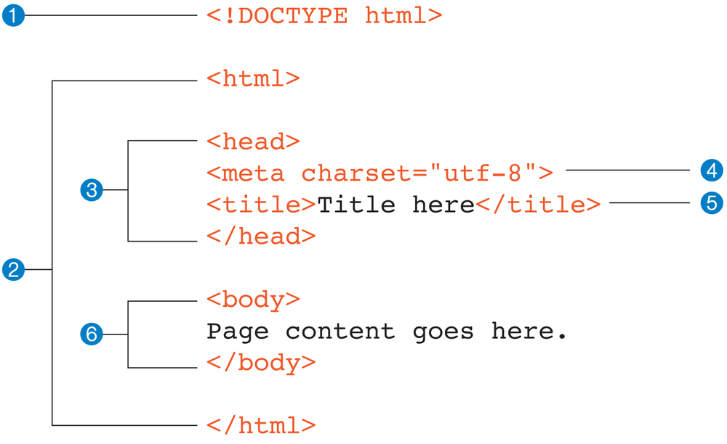
Structure HTML Page

Slide 13
Structure of HTML Page
<!DOCTYPE html>
declaration defines that this document is an HTML5 document
<html>
element is the root element of an HTML page
<head>
element contains meta information about the HTML page
<title>
element specifies a title for the HTML page (which is shown in the browser's title bar or in the page's tab)
<meta>
element tells browser about page settings.
<body>
element defines the document's body, and is a container for all the visible contents, such as headings, paragraphs, images, hyperlinks, tables, lists, etc.

Slide 14
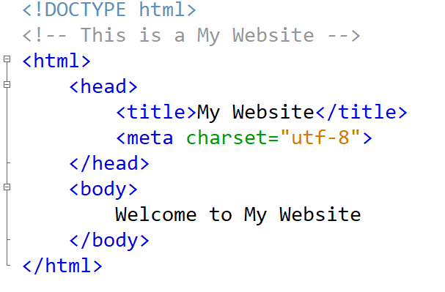
HTML comment tag
<!-- some comments -->

Slide 15
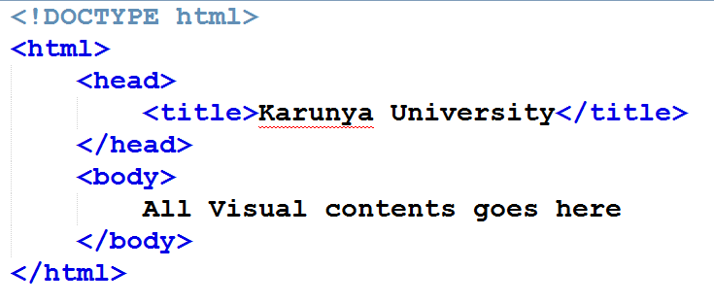
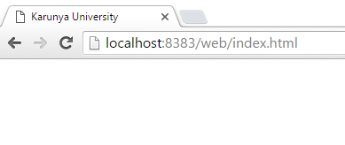
Header(<head>)
Use the <title> tag for the title of the page.

Slide 16
<meta> tag
<meta> tag defines metadata about an HTML document.
<meta> tags always go inside the <head> element, and are typically used to specify
character set
page description
keywords
author of the document
viewport settings
Refresh time limit

Slide 17
<meta> tag
<!DOCTYPE html>
<html lang="en">
<head>
<meta charset="UTF-8">
<meta http-equiv="refresh" content="10">
<meta name="viewport" content="width=device-width, initial-scale=1.0">
<meta name="description" content="mobile,tv,gadgets">
<title>Document</title>
</head>
<body>
</body>
</html>

Slide 18
Setting Viewport
What is The Viewport?
The viewport is the user's visible area of a web page.
The viewport varies with the device, and will be smaller on a mobile phone than on a computer screen.
<meta name="viewport"
content="width=device-width, initial-scale=1.0">

Slide 19
Body ( <body> )
The contents of the web page (mainly text)
Headings
Paragraphs, division and line breaks
Text Formatting
Links and Images
Tables
Fonts and Colors
Comments and etc
The above tags are used inside <body> tag.

Slide 20
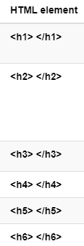
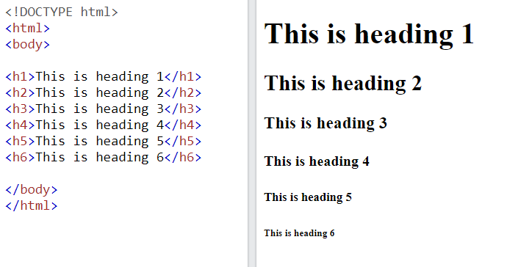
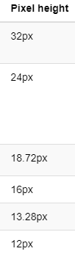
HTML Headings
HTML headings are defined with the <h1> to <h6> tags.
<h1> defines the bigger heading.
<h6> defines the smaller heading:

Slide 21
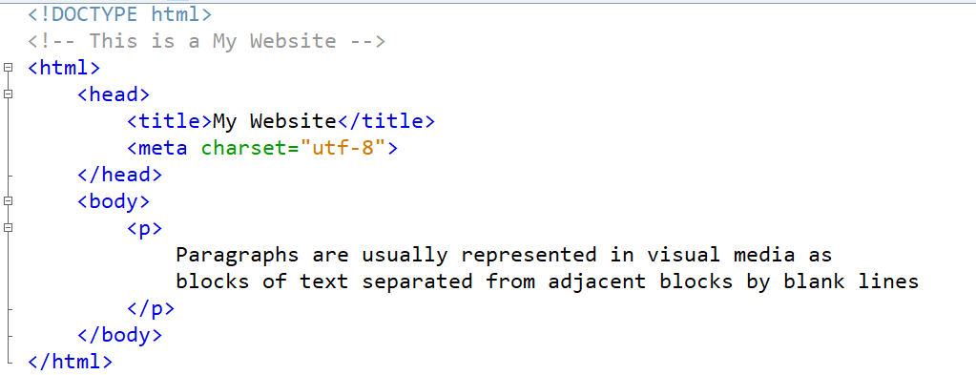
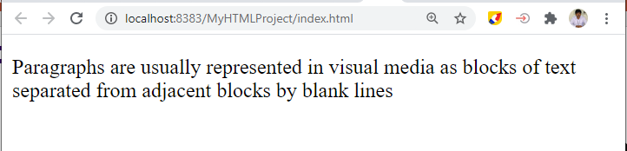
Paragraph
HTML <p> Tag
Used to display any paragraph of text content in a web page.
Browsers automatically add a single blank line before and after each <p> element.

Slide 22
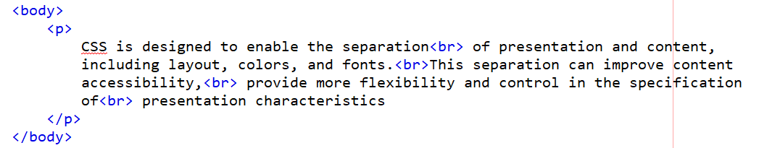
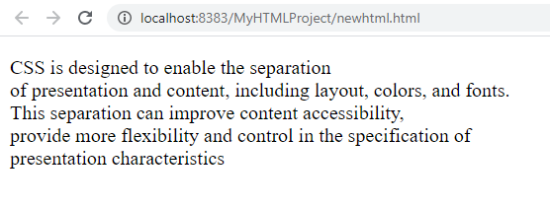
Line break using <br> tag
The <br> tag inserts a single line break.
The <br> tag is useful for writing addresses or poems.
The <br> tag is an empty tag which means that it has no end tag.

Slide 23
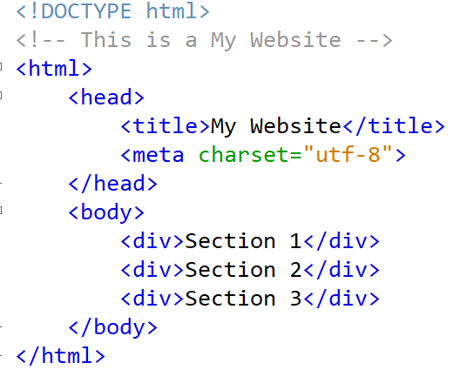
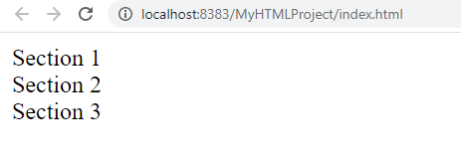
Add Section
The <div> tag defines a division or a section in an HTML document.
The <div> tag is used as a container for HTML elements

Slide 24
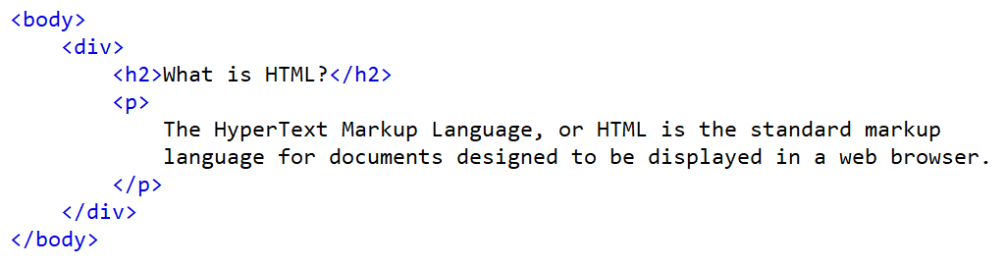
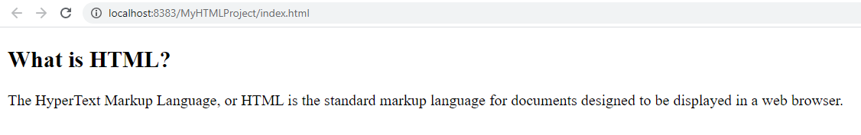
The <div> tag
Any sort of content can be put inside the <div> tag!
It is a container element.
By default, browsers always place a line break before and after the <div> element.

Slide 25
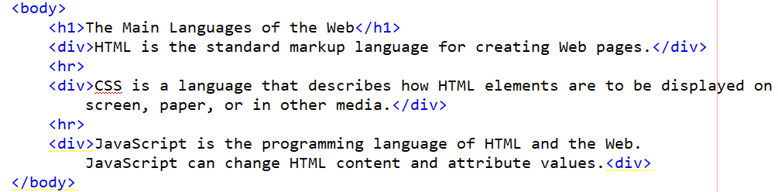
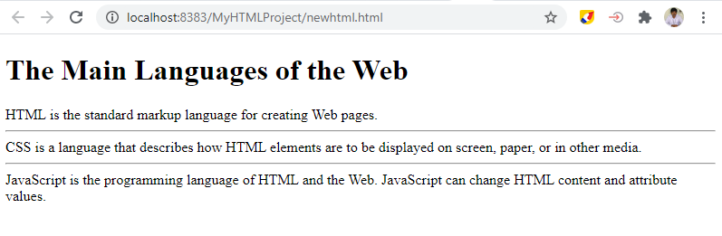
Horizontal Divider Line: <hr> tag

Slide 26
HTML Attributes
HTML attributes provide additional information for HTML elements or tag.
All HTML elements can have attributes
Attributes are always specified in the start tag
Attributes usually come in name/value pairs like: name="value“
Example attributes
lang - to set the language of web page
bgcolor – to set the background color of a web page
text - to set the text color
title - to give information about a particular element

Slide 27
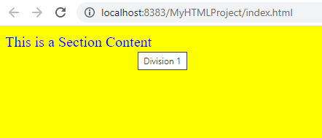
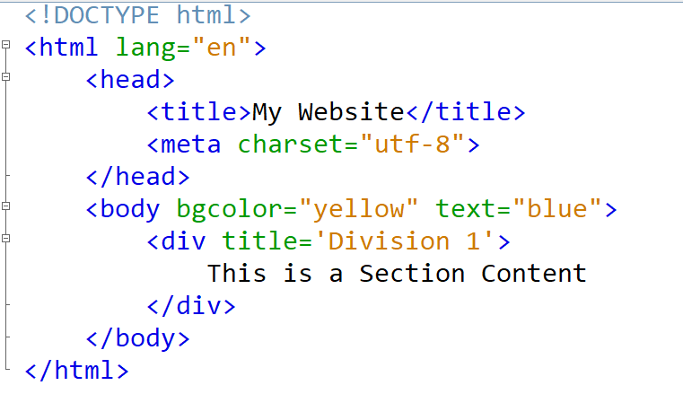
HTML Attribute- Example
en-English
Character set – Universal Transfer Format
Attributes: background color and text color
The title attribute value will be displayed when you keep the mouse over the div element.

Slide 28
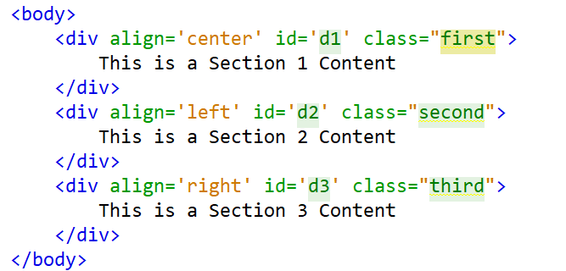
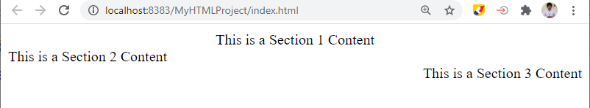
Other basic attributes
align – to set the alignment of text content
id – to set unique identifier to the tag or element(also used to style)
class – to set one or more class names to style the element.

Slide 29
<!DOCTYPE html>
<html lang="en">
<head>
<title>My Website</title>
<meta charset="UTF-8">
<meta name="viewport" content="width=device-width,initial-scale=1.0">
<meta http-equiv="refresh" content="10">
</head>
<body bgcolor="yellow" text="blue">
<div title="Division1" align="center" id="d1">
<p>This is sample text1</p>
<p>This is sample text2</p>
</div>
<div title="Division2" align="left" id="d2">
<p>This is sample text1</p>
<p>This is sample text2</p>
</div>
</body>
</html>
Example Program

Slide 30
Text Formatting Tags
<b> - Bold text
<u> - Underlined text
<i> - Italic text
<strong> - Important text (similar to <b>)
<em> - Emphasized text (similar to <i>)
<mark> - Marked text
<del> - Deleted text
<ins> - Inserted text (similar to <u>)
<sub> - Subscript text
<sup> - Superscript text

Slide 31
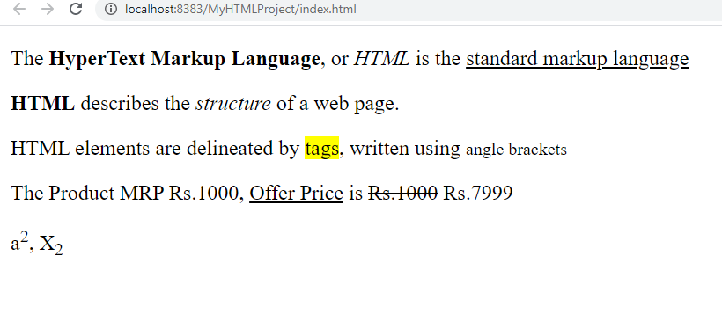
Exercise

Slide 32
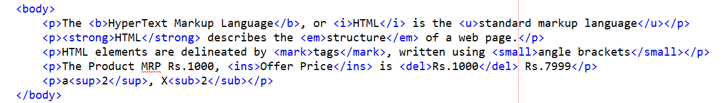
Text Formatting Tags - Example

Slide 33
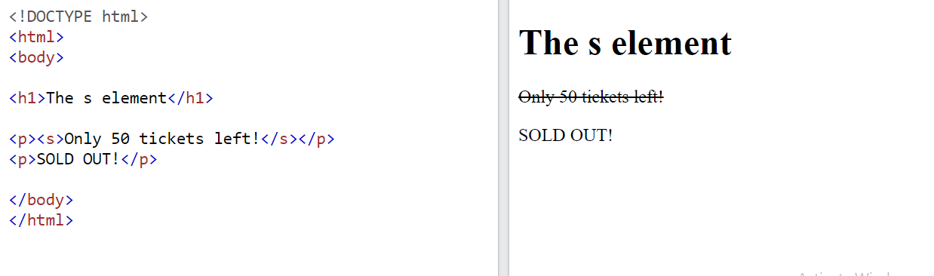
Alternate tag for <del>
<s> tag specifies text that is no longer correct, The text will be displayed with a line through it.

Slide 34
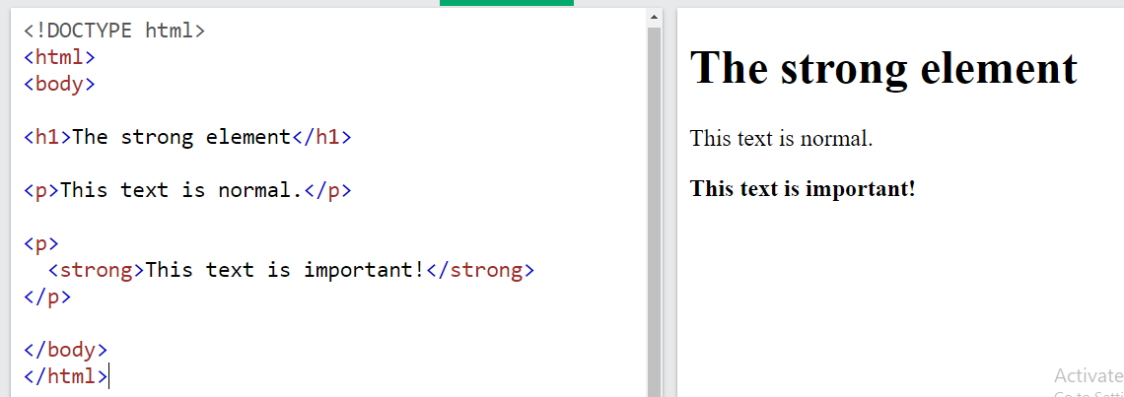
Alternate tag for <b>
<strong> used to indicate a text in bold

Slide 35
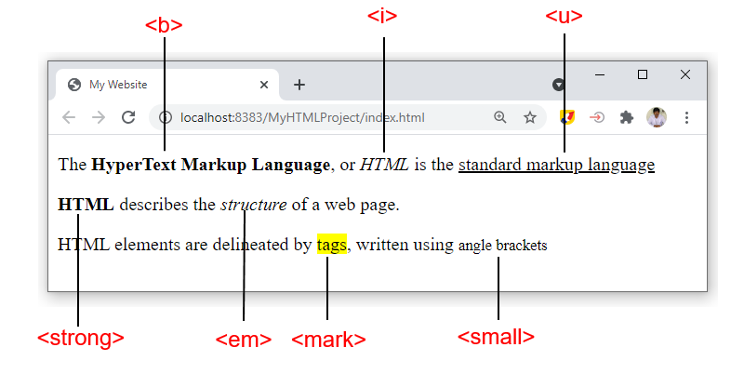

Slide 36
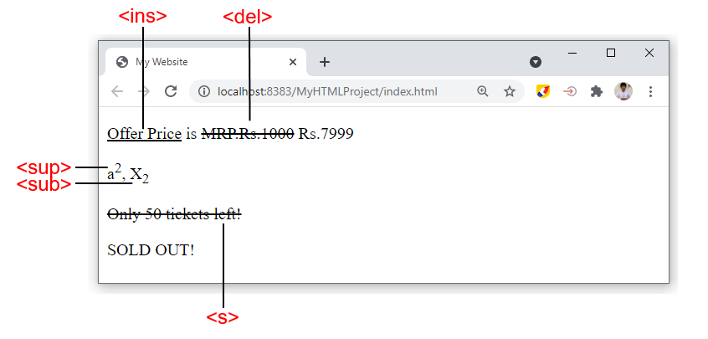

Slide 37
HTML Block and Inline Elements
Every HTML element has a default display value, depending on what type of element it is.
There are two display values:
Block element
A block-level element always starts on a new line.
A block-level element always takes up the full width available.
A block level element has a top and a bottom margin, whereas an inline element does not.
Example: <h1> to <h6>, <p>,<div> and etc..
Inline element
An inline element does not start on a new line.
An inline element only takes up as much width as necessary.
Example: <span>, <a>, <img>, and etc..

Slide 38
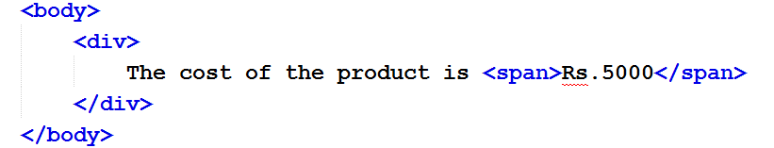
HTML <span> Tag
The <span> tag is used to group inline-elements in a document.
The <span> tag provides no visual change by itself.
The <span> tag provides a way to add a hook to a part of a text or a part of a document.
Example
span is used to format and manage a part of content.

Slide 39
Display data in List format
HTML lists allow web developers to group a set of related items in lists.
Types of List in HTML
Ordered List
Unordered List
Description List

Slide 40
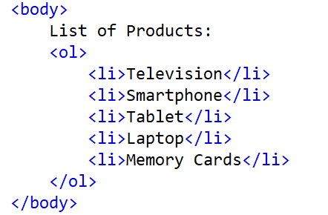
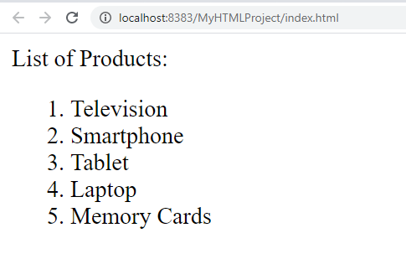
Display data in List format
Ordered List
An ordered list starts with the <ol> tag. Each list item starts with the <li> tag.
The list items will be marked with numbers by default:

Slide 41
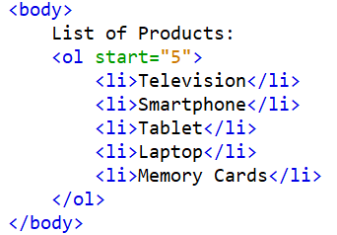
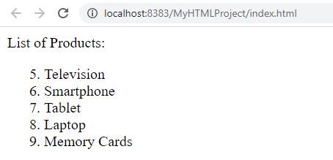
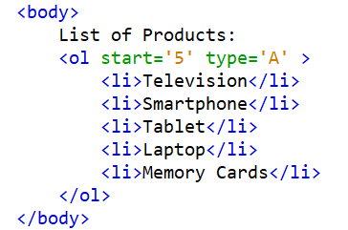
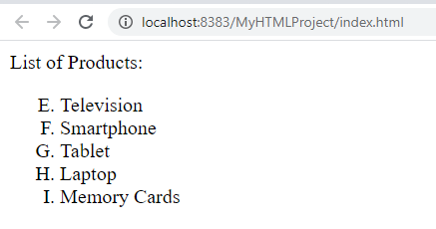
Display data in List format
Ordered List – Change the start value and type marker
Attributes: start, type= 1,A,a,I,i

Slide 42
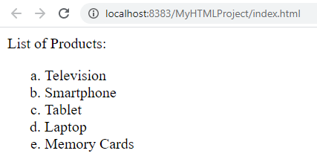
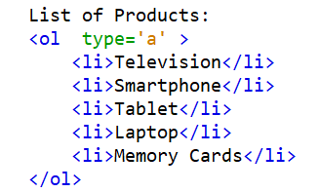
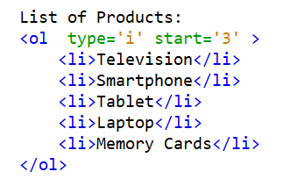
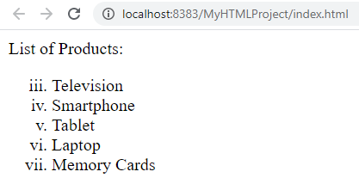
Display data in List format
Ordered List – Change the start value and type marker
Attributes: start, type= 1,A,a,I,i

Slide 43
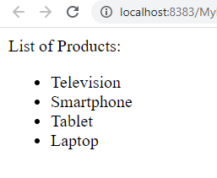
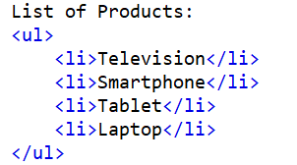
Display data in List format
Unordered List
The <ul> tag defines an unordered (bulleted) list.
Use the <ul> tag together with the <li> tag to create unordered lists.

Slide 44
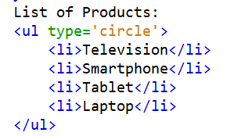
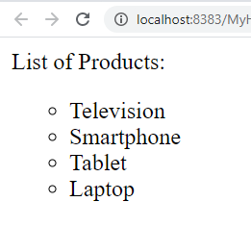
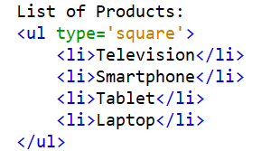
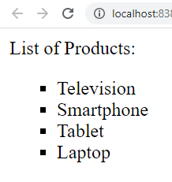
Display data in List format
Unordered List
The <ul> tag has attribute called type to change the bulletin mark.
type may be disc(default), circle, or square

Slide 45
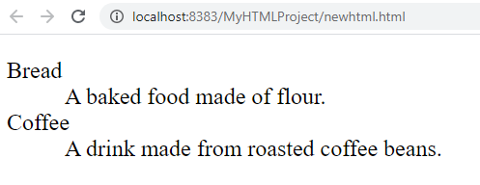
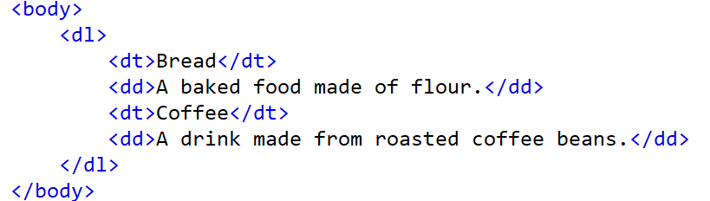
Display data in List format
Description List
A description list is a list of items with a description or definition of each item. The description list is created using <dl> element.
The <dl> element is used in conjunction with the <dt> element which specify a term, and the <dd> element which specify the term's definition.

Slide 46
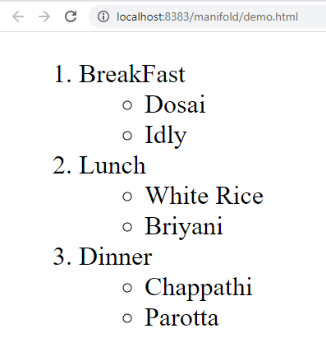
Nested List

Slide 47
Nested Lists
A list inside another list is called as nested list.
<ol>
<li>BreakFast
<ul>
<li>Dosai</li>
<li>Idly</li>
</ul>
</li>
<li>Lunch
<ul>
<li>White Rice</li>
<li>Briyani</li>
</ul>
</li>
<li>Dinner
<ul>
<li>Chappathi</li>
<li>Parotta</li>
</ul>
</li>
</ol>

